Slide 1
F R A U D U L E N T C L A I M D E T E C T I O N
P R E D I C T I V E M O D E L I N G T O P R E V E N T
I N S U R A N C E F R A U D
Onkar Hankare(onkarhankare26@gmail.com)
Nasrin Khatun(nasrinofficial786@gmail.com)

Slide 2
I N T R O D U C T I O N
Insurance fraud leads to significant financial
losses and operational inefficiencies. Manual fraud detection methods delay claim processing and increase costs.

Slide 3
PROBLEM STATEMENT
Current fraud investigations rely heavily on manual reviews, leading to delays and errors.
Legitimate claims suffer while fraudulent ones may go unnoticed.

Slide 4
PROJECT GOAL
To develop a model to classify claims as fraudulent or legitimate using features like claim amount, incident details, customer profile, and approval timelines.

Slide 5
A B O U T T H E D ATA S E T
The dataset contains 1000 entries and 39 columns, including:
Customer: age, occupation, hobbies
Policy: coverage, premiums
Incident: type, severity, location
Claim: amount, type
Vehicle: make, model, year

Slide 6
D ATA P R E P R O C E S S I N G & C L E A N I N G
Missing values were addressed (e.g.,property_damage, police_report).
Categorical variables were encoded using Label Encoding.
Data normalized for modeling.

Slide 7

Fraudulent
FRAUDLENT VS LEGITIMATE CLAIMS
Fraudulent
Legitimate

Slide 8
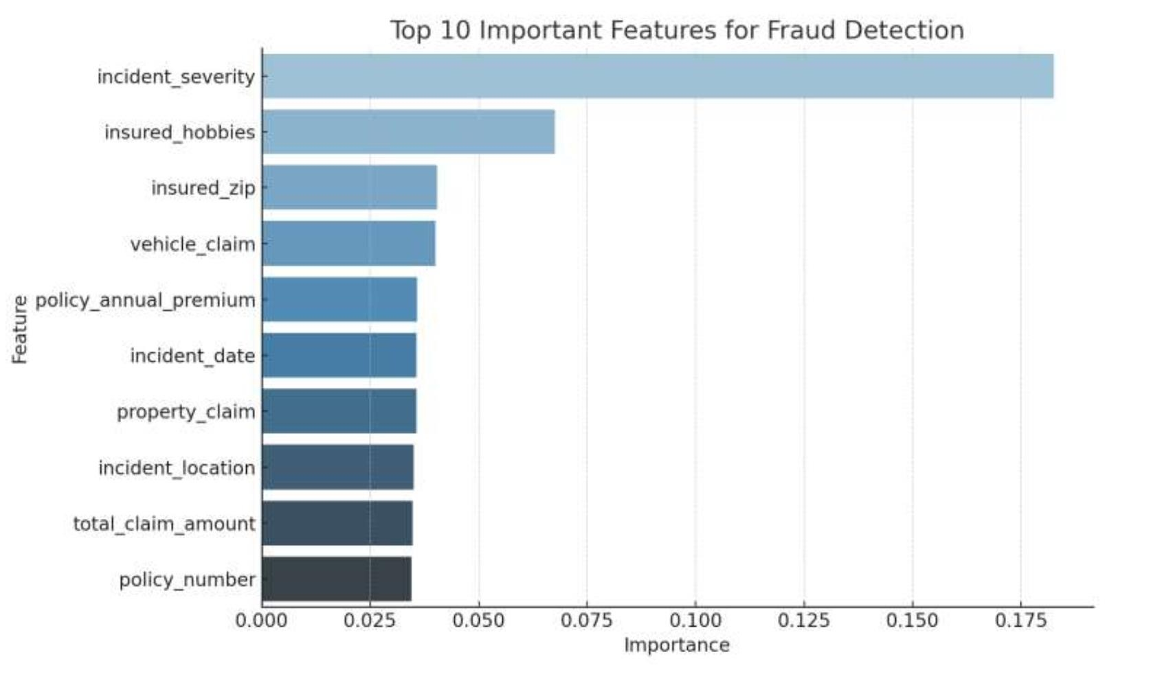
T O P P R E D I C T I V E F E AT U R E S
8

Slide 9
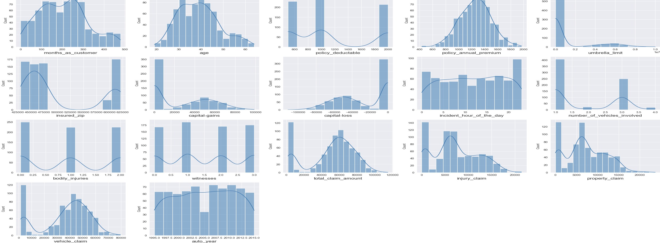
Visualising the distribution of selected numerical features using appropriate plots to understand their characteristics
4 / 7 / 2 0 2 5

Slide 10
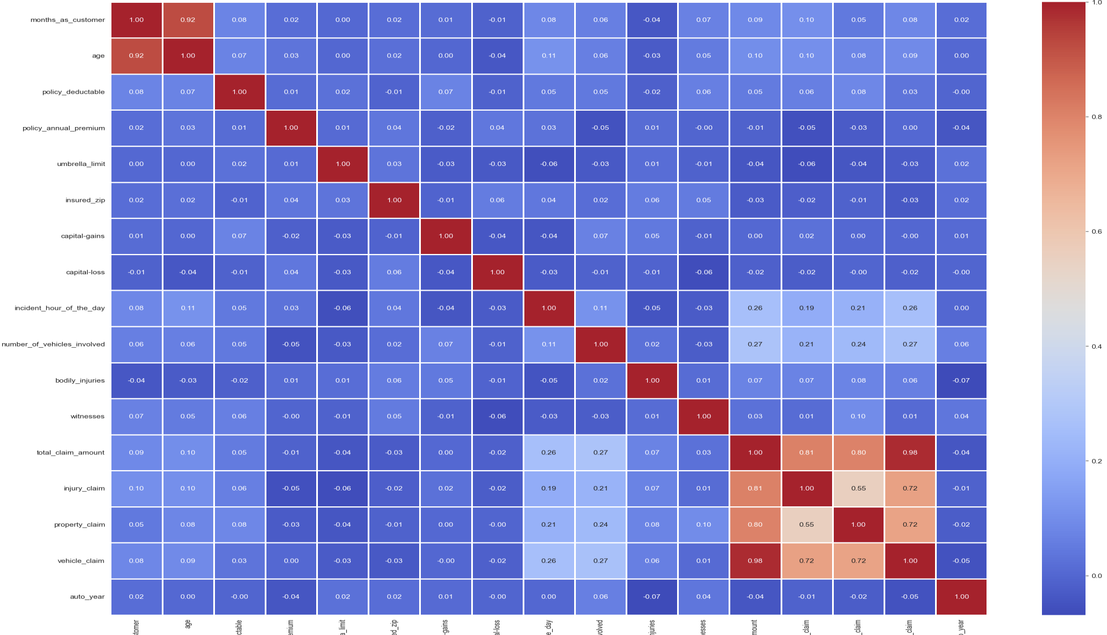
Investigating the relationships between numerical features to identify potential multicollinearity or dependencies and visualising the correlation structure using an appropriate method to gain insights into feature relationships.

Slide 11
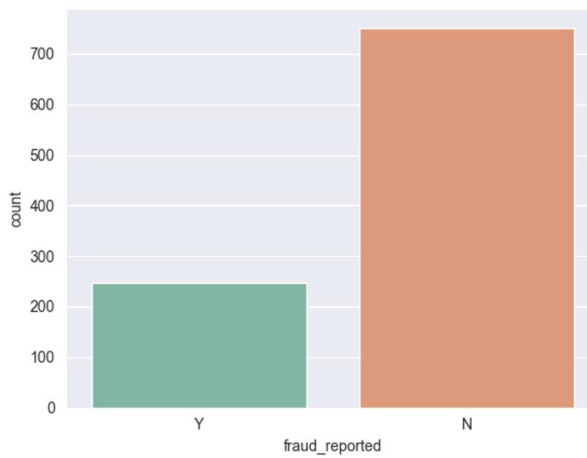
Examining the distribution of the target variable to identify potential class imbalances using visualisation for better understanding.

Slide 12
M O D E L I N G A P P R O A C H
We trained a Random Forest classifier using encoded features.
Train-test split used to evaluate model performance with cross- validation.
Tuning the model using appropriate technique like optimizing hyper parameters, make predictions and observe the performance with relevant metrics.

Slide 13

M O D E L P E R F O R M A N C E
Random Forest showed high accuracy and
strong fraud detection capability.
Metrics: Precision, Recall, F1-Score used to measure model quality.

Slide 14
I N S I G H T S F R O M T H E M O D E L
High claim amounts and certain incident types are strong indicators of fraud.
Features like police reports and witness availability also show significance.

Slide 15
R E C O M M E N D AT I O N S
Use model scores to flag high-risk claims early.
Allocate investigator resources based on fraud probability.
Automate claim triage using predictive output.

Slide 16
B U S I N E S S I M P L I C AT I O N S
Reduce financial losses from fraud.
Speed up processing of genuine claims.
Improve overall customer satisfaction and operational efficiency.

Slide 17
TH ANK YO U

